Slide 1
Chapter 8: Technology is used to treat diseases

Slide 2
8.1 Recombinant DNA
Biotechnology uses cellular processes to make products that are of use to humans.
For thousands of years people have been using yeasts to make bread and alcohol, and bacteria to make cheese and yoghurt.
Modern biotechnology has dramatically expanded the range of techniques and products that can be used to improve human welfare. Improvements in the treatment and prevention of disease, food production, production of clean energy and enhanced efficiency of manufacturing processes are all resulting from advances in biotechnology.
Therefore, the definition of biotechnology has more recently been expanded to include genetic testing, gene manipulation, cell replacement therapies and tissue engineering.

Slide 3
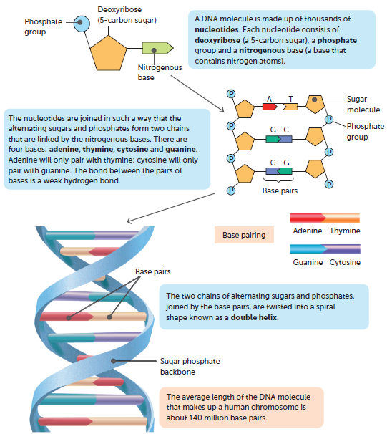
8.1 Recombinant DNA
Many methods of modern biotechnology utilise our understanding of DNA and apply it to specific processes.
DNA
DNA consists of two strands of alternating sugars and phosphates with pairs of nitrogen bases forming cross-links between the chains. The two strands are twisted into a double helix

Slide 4
8.1 Recombinant DNA
Recombinant DNA technology
Recombinant DNA technology, or genetic engineering, involves artificially changing DNA and produces a genetically modified organism (GMO). This technology has a wide range of possible uses, including introducing genes for desired traits into organisms, using harmless bacteria to produce proteins, and replacing faulty genes.
If this organism has DNA from another species, it is called a transgenic organism. The aim of transgenic organisms is to introduce a trait that is not normally present. All transgenic organisms are GMOs, but not all GMOs are transgenic. One example of a transgenic organism is Golden Rice, which was developed to address vitamin A deficiency in developing countries.

Slide 5
8.1 Recombinant DNA
Development of recombinant DNA technology
Stanley Norman Cohen and Herbert Boyer invented the recombinant DNA technique in 1973. Their technique was to isolate and amplify genes or DNA segments and insert them into a bacterial cell, creating a transgenic bacterium. The introduced genes become part of the transgenic organism’s DNA and can be passed on from one generation to the next.

Slide 6
8.1 Recombinant DNA
Restriction enzymes
For genetic engineering to be possible, the gene for the desired trait must be identified and then isolated. Next, the DNA receiving the gene must be ‘opened’, and the gene is then added to the recipient and joins its DNA.
A key breakthrough in genetic engineering involved viruses that infect bacterial cells. These are called bacteriophages, or phages. It was discovered that certain enzymes in bacteria are able to restrict the duplication of bacteriophages by cutting up the viral DNA. Scientists found that these enzymes always cut the DNA at a point where there is a certain sequence of bases. This sequence is known as a recognition site (or recognition sequence), and the enzyme that cuts the DNA is a restriction enzyme because it restricts the duplication of bacteriophages.

Slide 7
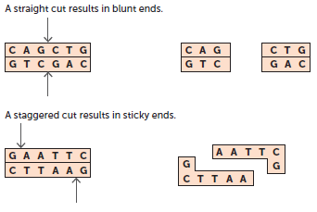
8.1 Recombinant DNA
Restriction enzymes are examples of endonucleases, enzymes that cut within a DNA molecule by separating two nucleotides. Some restriction enzymes produce a straight cut at the sequence, while others produce a staggered cut.
A straight cut is when the restriction enzyme makes a clean break across the two strands of DNA to produce a blunt end. A blunt end is when both strands terminate in a base pair.
A staggered cut results in fragments with sticky ends. A sticky end is a stretch of unpaired nucleotides in the DNA molecule that overhang at the break in the strands.

Slide 8
8.1 Recombinant DNA
Recognition sites are four to eight base pairs in length and are palindromic, meaning that they have the same sequence when read both forward and backwards. This, along with the complementary nature of the bases, means that the same sequence occurs on both strands within the recognition site.
Therefore, both strands will be cut, resulting in the DNA molecule forming two segments.
Each restriction enzyme will:
recognise a certain base sequence
cut at a certain point.
Both of these factors contribute to the type of cut.
Sticky ends are so named because of their ability to combine with sections of DNA that have a complementary ending. These are very useful in recombinant DNA technology as they allow a single-stranded overhang from one DNA fragment to be paired with any other piece of DNA that has a corresponding sequence. This DNA could be from the same or a different organism.

Slide 9
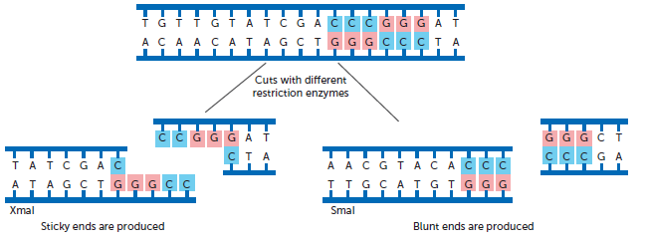
8.1 Recombinant DNA
The recognition site and position of the cut determine the types of ends produced by restriction enzymes

Slide 10
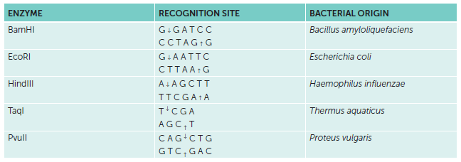
8.1 Recombinant DNA
Examples of restriction enzymes

Slide 11
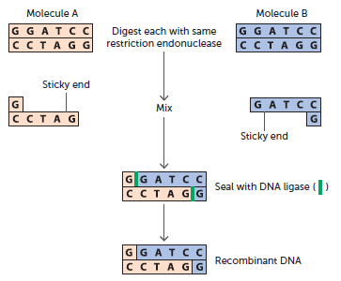
8.1 Recombinant DNA
DNA ligase
Another major breakthrough in being able to modify genes was the discovery of an enzyme that was able to join, or recombine, separate pieces of DNA. This enzyme, found in the bacterium E. coli, is known as DNA ligase. Some version of DNA ligase is used by every living cell to ‘glue’ together short strands of DNA during replication, a process called ligation.
DNA ligase works by joining the phosphate group at the end of one strand to the sugar molecule at the end of another strand. For this to be possible, the complementary bases must first join by forming hydrogen bonds. Then the DNA ligase can join the backbone of each strand.

Slide 12
8.1 Recombinant DNA
Use of vectors
In genetic engineering, a vector is a DNA molecule that is used to carry DNA into a cell. The first step in producing an organism with recombinant DNA is to isolate the gene of interest. This gene is then inserted into a vector and cloned. This is achieved by:
1 identifying the desired gene
2 using a restriction enzyme to cut the DNA on either side of the gene
3 using the same restriction enzyme to cut the DNA of the vector
4 adding the desired gene to the vector
5 using DNA ligase to join the two sections of DNA.
In recombinant DNA technology, commonly used vectors are bacterial plasmids and bacteriophage viruses.

Slide 13
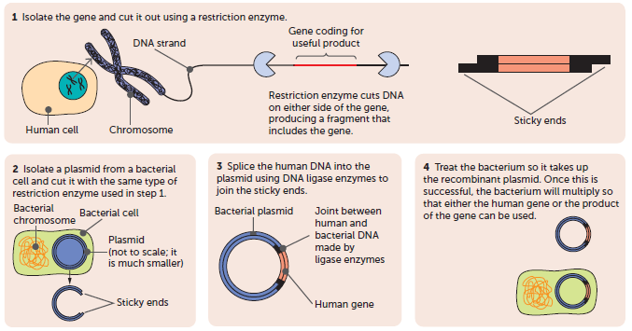
8.1 Recombinant DNA
A simplified diagrammatic representation of recombinant DNA technology

Slide 14
8.1 Recombinant DNA
Examples of the use of recombinant DNA technology
Recombinant DNA technology has had an enormous impact on the diagnosis and treatment of diseases and genetic disorders. It has also enabled the manufacture of large quantities of pure protein for many medical products, including insulin, growth hormone, factor VIII and follicle-stimulating hormone (FSH).
In the past these substances had to be extracted from people or animals, and they were often impure and/or of variable strength.

Slide 15
8.1 Recombinant DNA
Recombinant DNA and vaccines
Most of the vaccines currently being investigated are focused on using recombinant bacterium E. coli or cells from mammals, insects or yeast to produce protein antigens. These can be introduced to the body, where they will elicit an immune response. Vaccines produced using recombinant DNA are known as recombinant vaccines.
Currently, the vaccine for hepatitis B is produced using recombinant technology (see diagram on next slide). The gene for a surface antigen on the virus is isolated and added to a plasmid. The plasmid is introduced into a yeast cell. When the yeast cell divides, the new cells also contain the plasmid with the gene for the antigen. This gene allows the yeast cells to produce the antigen protein, which can be collected and purified.

Slide 16
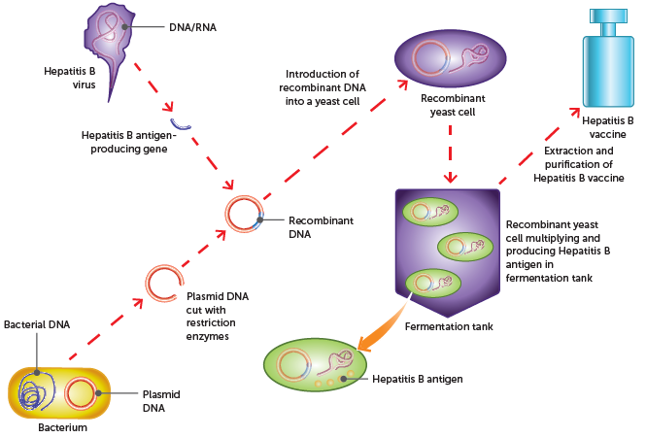
8.1 Recombinant DNA

Slide 17
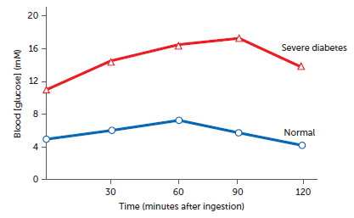
8.2 Synthetic hormones
Diabetes mellitus
Diabetes is a hormonal problem that seriously disrupts homeostasis. A person with diabetes has an abnormally high blood glucose level, a condition called hyperglycaemia.
The main role of insulin is to lower the levels of glucose in the blood by stimulating cells to take in glucose, and by liver and muscle cells converting glucose into glycogen. If a person produces insufficient insulin, or if their cells are resistant to the effects of insulin, the amount of glucose in the blood remains high and they excrete large quantities in the urine.
Glucose levels following ingesting insulin

Slide 18
8.2 Synthetic hormones
Type 1 diabetes
Type 1 diabetes, sometimes called insulin-dependent diabetes, usually begins in childhood. In Australia, 10–15% of diabetes patients suffer from type 1. It occurs because a fault in the patient’s immune system causes the destruction of beta cells in the islets of Langerhans of the pancreas. Beta cells produce insulin; therefore, a person with type 1 diabetes does not produce insulin. In most cases, the person’s cells respond to insulin in the normal way, so the disease can be managed by giving the person insulin.
The only treatment is regular injections of insulin or the use of a programmable pump that provides a continuous supply of insulin under the skin. Insulin injections do not cure type 1 diabetes; they ensure the body is able to function. The patient must have regular injections to stay alive, but even with injected insulin the long-term effects are likely to be kidney failure, heart attack, stroke, amputations, blindness or nerve damage.

Slide 19
8.2 Synthetic hormones
Type 2 diabetes
Type 2 diabetes is also known as non-insulin-dependent or adult-onset diabetes. It usually develops in people over the age of about 45 years. Type 2 patients are able to produce insulin, but their cells do not respond to it.
Type 2 diabetes is a lifestyle disease; it is more common in people who are not physically active and are overweight or obese.
Lifestyle factors that increase the risk of developing type 2 diabetes include:
lack of physical activity
being overweight or obese
a diet that is regularly high in fat, sugar and salt, and low in fibre
high blood pressure
high blood cholesterol
smoking.

Slide 20
8.2 Synthetic hormones
Because the cells do not respond to insulin, they do not take up glucose from the blood. Therefore, a blood test taken after fasting (not eating) will detect abnormally high levels of glucose.
There is no cure for type 2 diabetes, but the earlier a diagnosis is made, the better the chances of successful management of the condition. Treatment involves a management program that aims to keep blood glucose levels within the normal range. Management includes a careful diet, regular physical activity, maintaining a healthy weight, monitoring blood glucose, and sometimes medication if blood glucose cannot be controlled by other measures.
Type 2 diabetes is preventable. The chances of suffering from the disease can be reduced by adopting a healthy lifestyle.

Slide 21
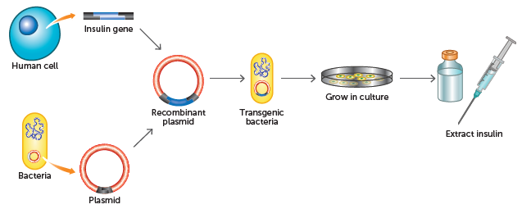
8.2 Synthetic hormones
Treating diabetes
The insulin for treatment of diabetics used to be obtained from the pancreases of cows and pigs. This made supplies of insulin expensive and limited.
Recombinant DNA now allows bacteria to produce human insulin almost all the insulin used throughout the world is now biosynthetic recombinant ‘human’ insulin rather than animal insulin.

Slide 22
8.2 Synthetic hormones
Thyroid disorders
The thyroid gland is located in the neck and secretes two hormones: thyroxine (T4) and tri-iodothyronine (T3). Thyroxine affects nearly every tissue in the body by stimulating carbohydrate, protein and fat metabolism. Thus, the secretion of thyroxine from the thyroid regulates basal metabolic rate.
Some of the energy released from the chemical reactions stimulated by thyroxine is in the form of heat, which is important in maintaining body temperature. Thyroid hormones are therefore also important in the long-term homeostasis of body temperature by the gradual change in metabolic rate that occurs from summer to winter.
Secretion of thyroxine is controlled by thyroid-stimulating hormone (TSH). TSH is secreted by the anterior lobe of the pituitary, but its release is controlled by the hypothalamus in the brain. An excess of or a deficiency in thyroxine can cause disorders. This may be due to a problem in the thyroid itself, but in some cases it can be due to an imbalance in TSH.

Slide 23
8.2 Synthetic hormones
Hyperthyroidism
Too much thyroxine, called hyperthyroidism, occurs when the thyroid gland produces too much hormone. The most common type of hyperthyroidism is known as Graves’ disease. It is an enlargement of the thyroid caused by an immune system reaction.
Because the cells are overstimulated, and the metabolic rate is increased, the symptoms of hyperthyroidism are rapid heartbeat, weight loss, increased appetite, fatigue, sweating, anxiety and, in the case of Graves’ disease, protruding eyeballs, known as exophthalmia.

Slide 24
8.2 Synthetic hormones
During the production of thyroxine and tri-iodothyronine, iodine is absorbed from the bloodstream, concentrated in cells in the thyroid and then incorporated into the molecules to produce the hormones. Therefore, hyperthyroidism can be treated with drugs that block the thyroid gland’s use of iodine. Another method is to give the patient a drink containing radioactive iodine.
The radioactive iodine molecules are taken up by the thyroid cells, which are then killed by the radioactivity. Cells elsewhere in the body do not absorb iodine and are unaffected. The radioactive iodine is eventually excreted in the urine. A third method is to use surgery to remove some, or all of, the gland. Less thyroid gland will result in less hormone being produced.

Slide 25
8.2 Synthetic hormones
Hypothyroidism
Too little thyroxine, hypothyroidism, is much more common. It occurs either through problems with the thyroid, pituitary gland or hypothalamus. Symptoms of hypothyroidism arise due to a decrease in metabolism and may include slow heart rate, unexplained weight gain, fatigue or a feeling of lack of energy, intolerance to cold, swelling of the face, and goitre.
One thyroid gland problem is due to lack of iodine. A thyroxine molecule contains four iodine atoms (hence T4) and a tri-iodothyronine molecule contains three atoms of iodine (T3). Thus, a deficiency of iodine in the diet can prevent the thyroid gland from making enough hormones. The thyroid gland may then become enlarged in an effort to increase hormone production. Enlargement of the thyroid is known as goitre.
Although a severe deficiency of iodine can cause hypothyroidism, the most common cause is an attack on the thyroid gland by the patient’s immune system. This is known as Hashimoto’s disease. Another cause is surgery for cancer of the thyroid that involves removal of all, or a large part, of the gland.

Slide 26
8.2 Synthetic hormones
If the cause of hypothyroidism is a lack of iodine, it is easily treated by the inclusion of extra iodine in the diet. For treatment of other causes, tablets containing thyroid hormone are prescribed.
Hypothyroid patients used to be treated with tablets made from the dried and powdered thyroid glands of animals, mainly pigs. Today most patients are treated with hormones made synthetically by a chemical process. Levothyroxine is a manufactured form of thyroxine and is the most commonly prescribed drug for thyroid hormone replacement.

Slide 27
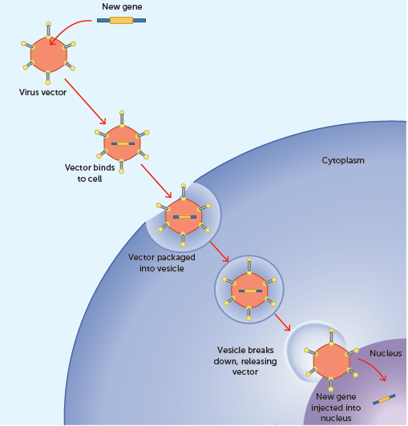
8.3 Other technologies
Gene therapy
Gene therapy aims to correct the cause of the problem by correcting the faulty gene. This can be achieved by replacing, correcting or inactivating the gene, or by inserting a new gene to correct the disease or to encourage the immune system to destroy the diseased cell.
A gene being introduced into a cell during gene therapy

Slide 28
8.3 Other technologies
Type 1 diabetes could possibly be treated with gene therapy by using vectors to introduce the gene for insulin into alpha cells so that they can produce the hormone and allow the body to function normally.
Genetic disorders such as cystic fibrosis and Huntington’s disease could possibly be treated with gene therapy by introducing the correct gene into the affected cells so that they can function normally.

Slide 29
8.3 Other technologies
Cell replacement therapy and tissue engineering
Any disorder involving loss of, or injury to, normal cells is a potential candidate for stem cell replacement therapy. However, cell replacement therapy for the nervous system has generated the most interest, for example neurodegenerative disorders such as Parkinson’s and Alzheimer’s diseases.
However, the use of human embryonic stem cells is controversial and raises a number of ethical questions. Researchers into Parkinson’s disease are currently exploring other sources of cells to help restore patients’ brain function.
Stem cells are increasingly being used for tissue engineering. The primary objective of tissue engineering is to restore healthy tissues or organs for patients and thus eliminate the need for tissue or organ transplants, or artificial implants. Early research in this area used cells from the intended recipient but, in many cases, such as genetic diseases, this was not practicable. In other situations, the organ from which cells were to be harvested was diseased, and so not enough normal cells were present to enable a successful culture. The use of stem cells overcomes both problems.

